Slide 1



Daily Typing Do-Now
Open typing.com
Log into your account
Complete a 1 minute typing test
With the remaining 4 minutes
Work on a typing lesson
Play a typing game
Complete more typing tests

Slide 2
Large Language Models
Intro to Computer Science

Slide 3

Schedule
Week 14
Monday - Neural Networks Structures
Tuesday - Language Modeling
Wednesday - LLMs
Thursday - Neural Network Coding
Friday - Modify Classifier Project

Slide 4
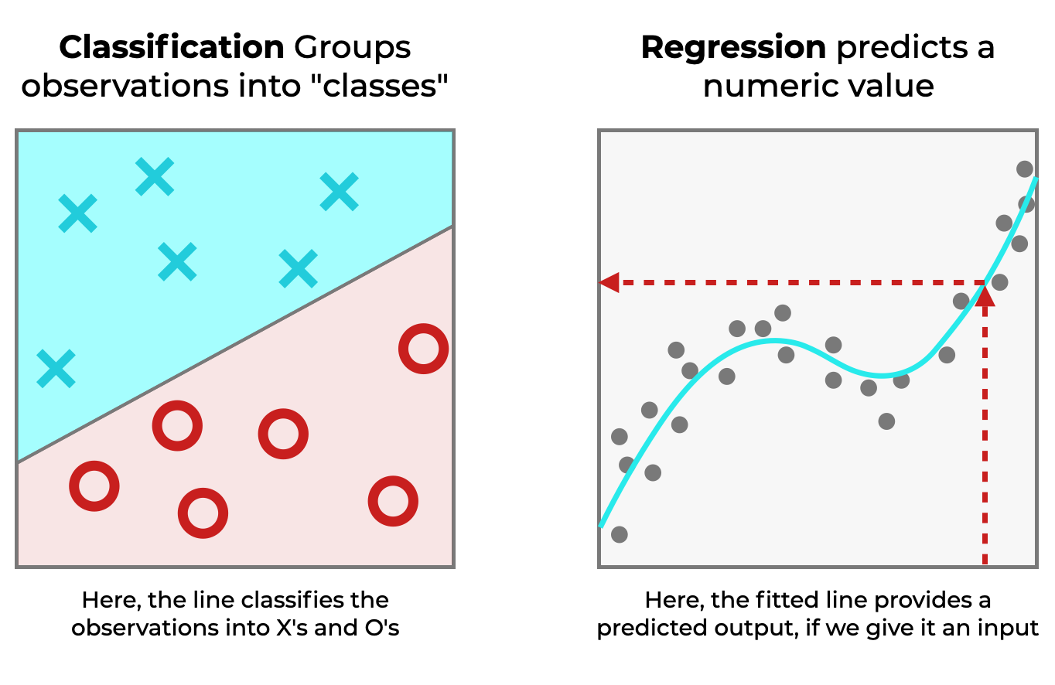
Tasks in Machine Learning

Slide 5
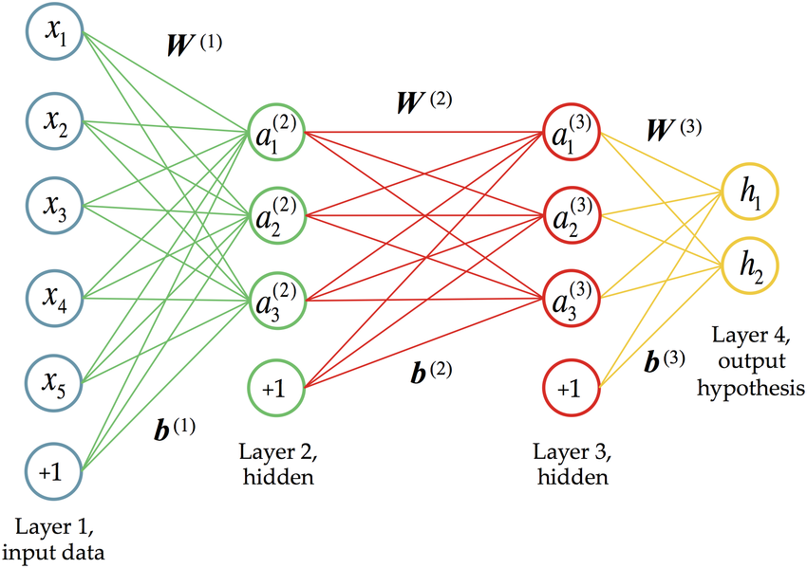
Neural Networks

Slide 6
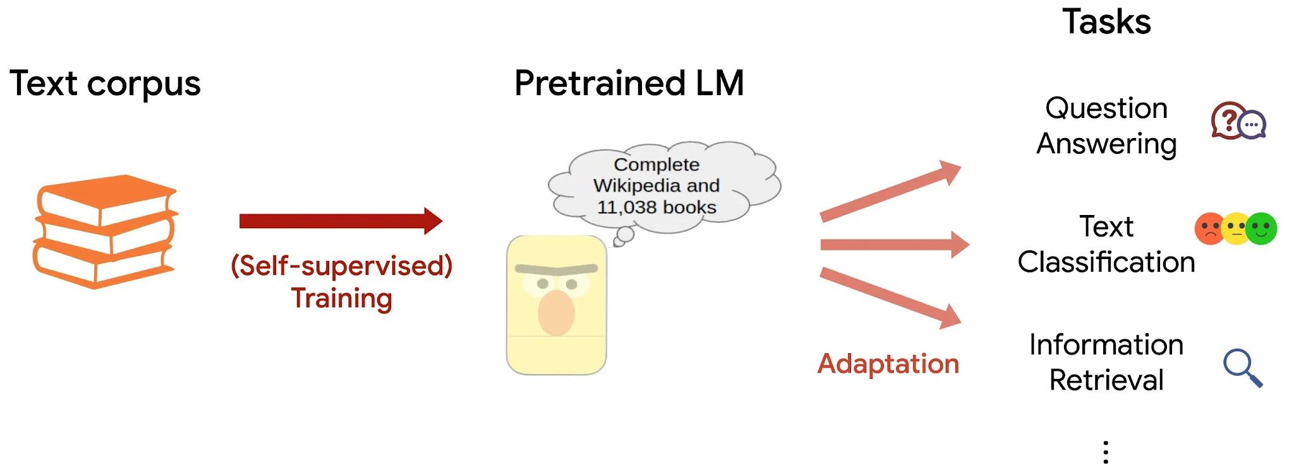
Language Modeling

Slide 7
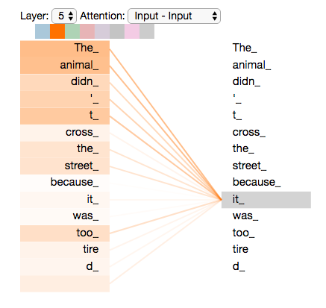
Transformers (2017)
Transformers are a mechanism for relating pieces of text to each other.
Transformers use a system of attention to see how each word relates to each other.
This creates an embedding that shows each words relation to each other word.
This embedding can be processed by a neural network to make predictions.

Slide 8

OpenAI
Founded as a non-profit in 2015 by Sam Altman, Elon Musck, Ilya Sutskever and others
Received $130 million in donations early on to perform open-source AI research
Converted to a for-profit in 2019

Slide 9
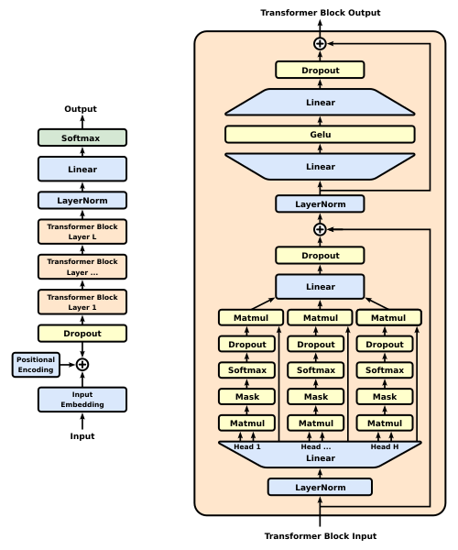
GPT (June 2018)
Stands for Generative Pretrained Transformer
Achieved modest improvements over previous models in language modeling tasks
5.8% improvement in textual entailment
4.2% improvement in paraphrase detection
5.7% improvement in multiple choice question answering
Used 12 transformer layers
117 million parameters

Slide 10
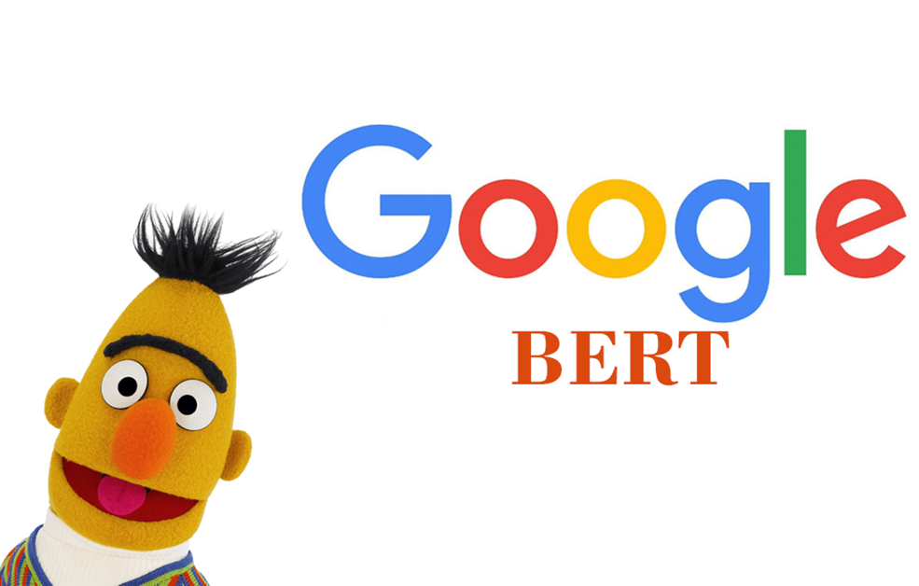
BERT (Oct 2018)
Developed by Google
Used word piece tokens
Used to vastly improve the quality of Google search results by processing the searches and results
Used 24 layers
Used 340 million parameters

Slide 11
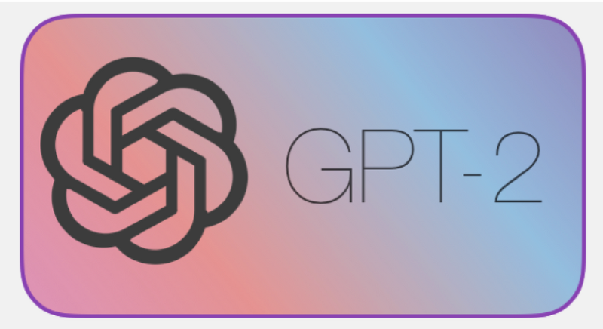
GPT-2 (Feb 2019)
Trained on 8 million web pages
Used a 48 layer network
Had 1.5 billion parameters
Could generate text
OpenAI limited access to the model, and did not release the source code
Cited concerns around malicious use for text generations

Slide 12
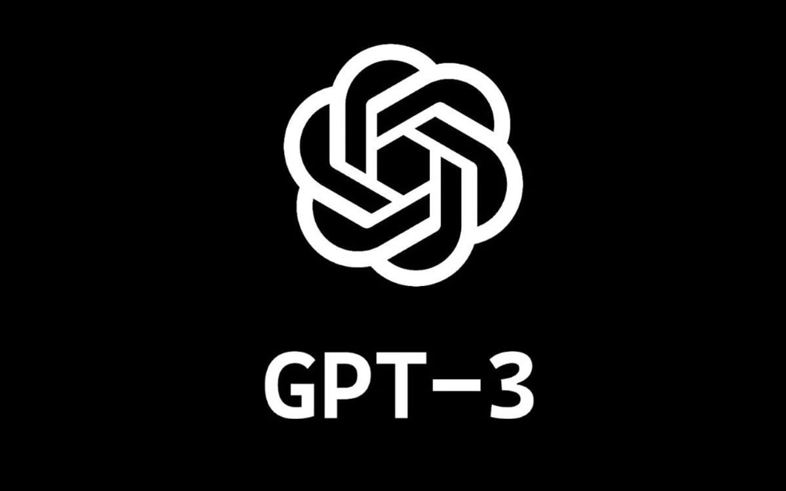
GPT-3 (May 2020)
Massive increase in model size
96 layers
175 billion parameters
Trained on the entire internet for data
Was able to perform “tasks” with limited prompting
Licensed exclusively by Microsoft

Slide 13
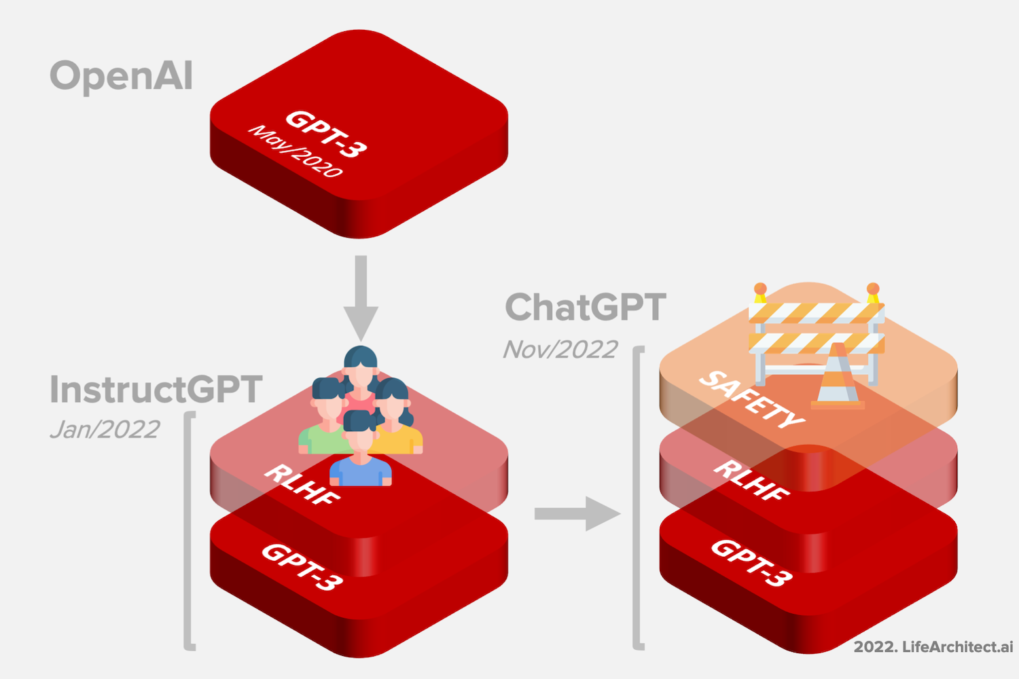
InstructGPT (Mar 2022)
GPT-3 given more training data related to instructions for tasks
Improved GPT-3s ability to complete human assigned tasks

Slide 14

ChatGPT (Nov 2022)
Built using the GPT-3 Model and released to the world in November 2022
Fasting growing consumer application in history with 100 million users
Improved with “reinforcement learning” from users
Sparked the current AI boom

Slide 15


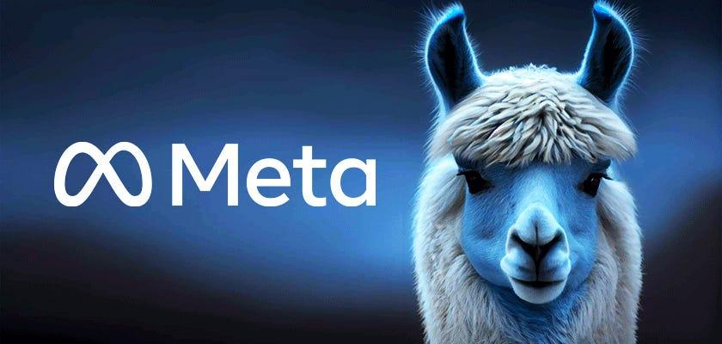
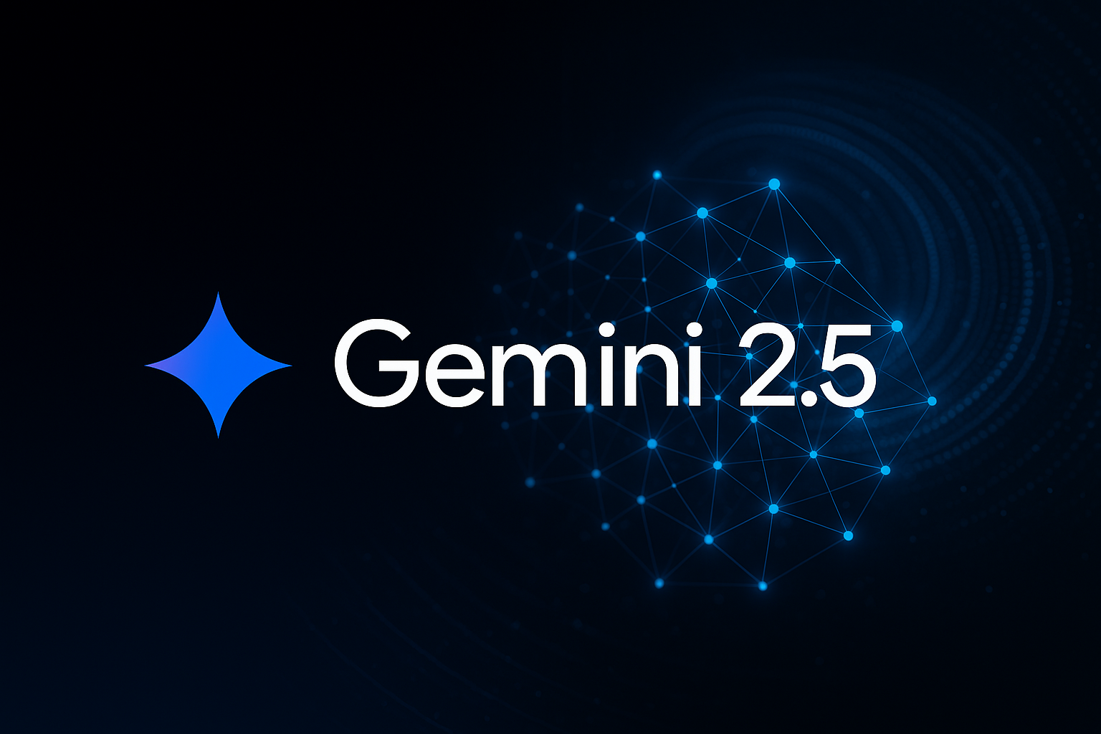
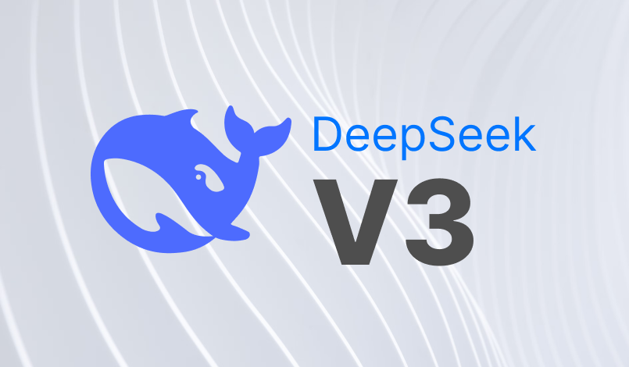

Current State of The Art

Slide 16
DeepSeek Source Code

